Slide 1
Ammonia concentration and emissions
2021.2.3

Slide 2
Current progress
Delta Concentration
Delta emission
Ratio of transport to emission/deposition

Slide 3

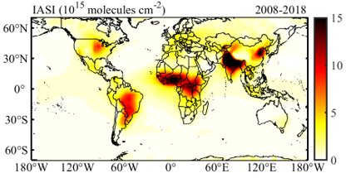
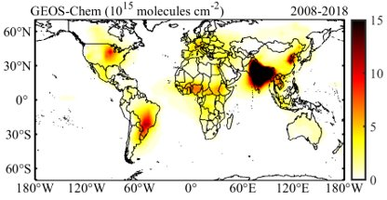
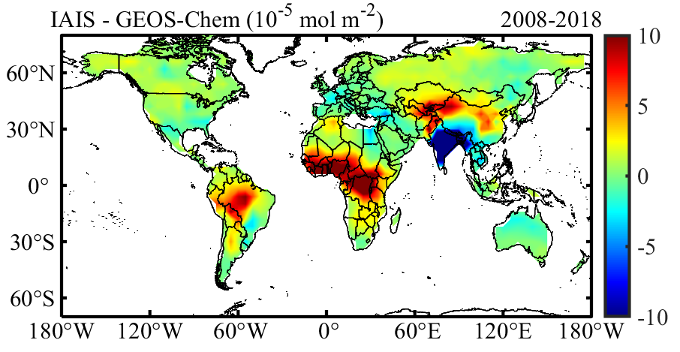
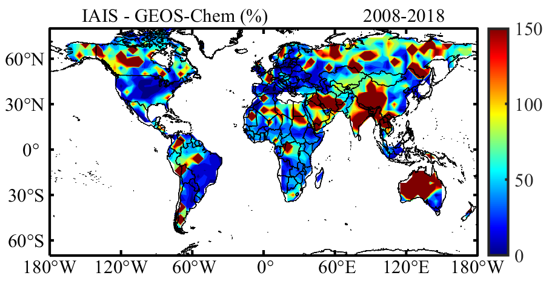
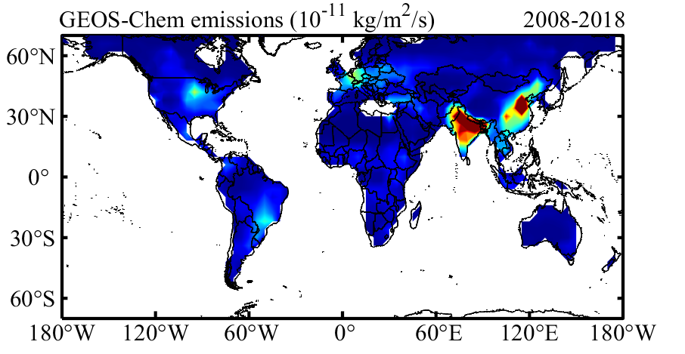
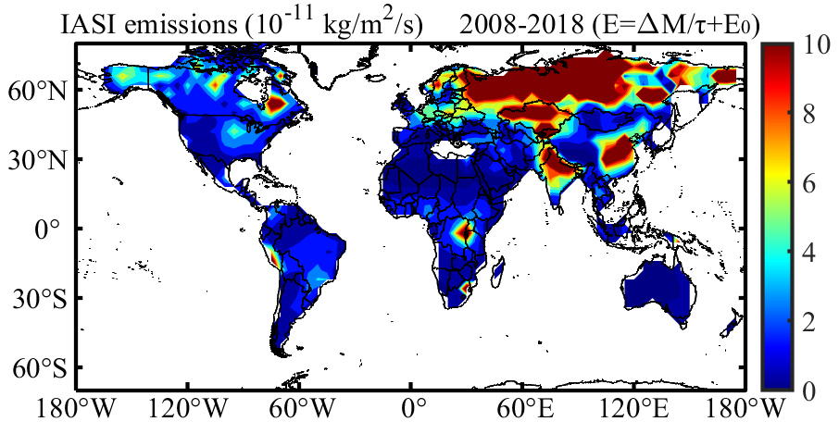
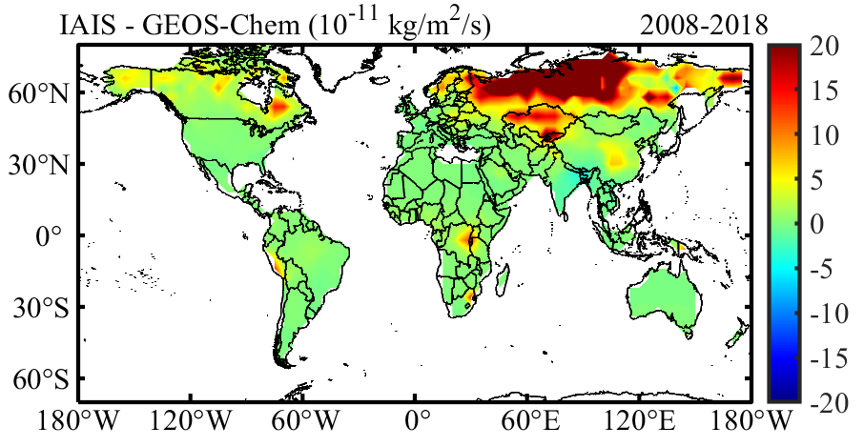
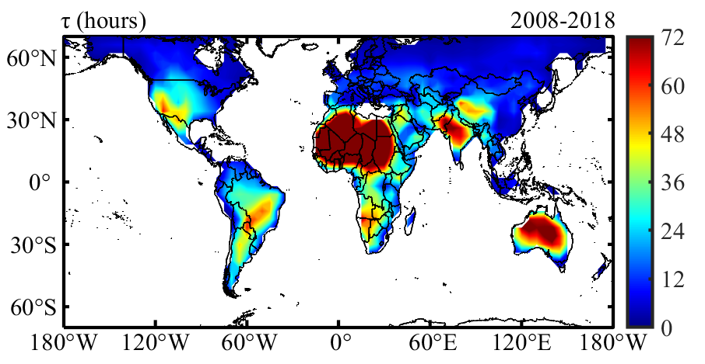
Concentration and emission difference between IASI and GEOS-Chem

Slide 4
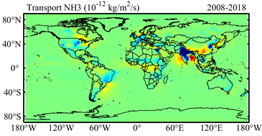
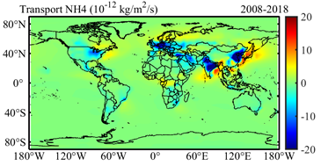
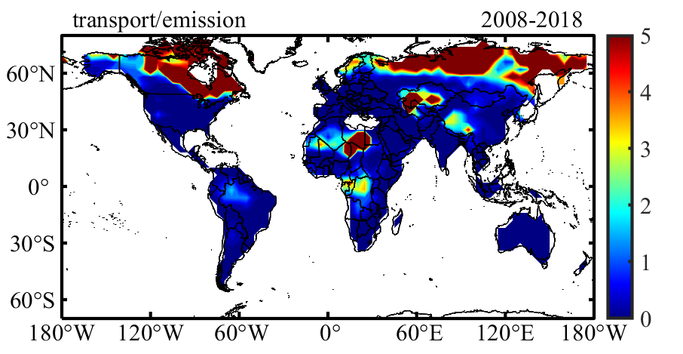
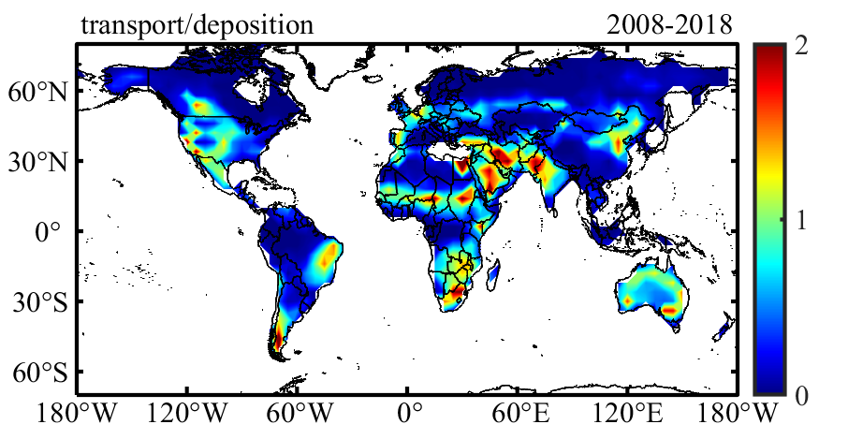



Ratio of transport (NH3 + NH4) to emission/deposition in GEOS-Chem
Transport/emission, transport > 0
Tansport /deposition, tansport < 0

Slide 5
Future plan
Filter the emission
Emission trend
Sort out the literature

